Slide 1
GESTURE CONTROLLED ROBOT USING IMAGE PROCESSING
Mentor :
Vadivelan Murugesan
( ECE III Year )
Members :
Jayaashree.P
Sakthi Priya.S
Shwetha.A
S.Subhashri
( ECE II Year )

Slide 2
ABSTRACT
This project is a real time monitoring system by which humans interacts with robots through gestures. Service robots directly interact with people, so finding a more natural and easy user interface is of fundamental importance. While earlier works have focused primarily on issues such as manipulation and navigation in the environment, few robotic systems are used with user friendly interfaces that possess the ability to control the robot by natural means. Gesture recognition consists of three stages: capturing of image, image processing and navigation of bot. The user can give commands to a wireless robot using gestures. Through this interface the user can control or navigate the robot by using gestures of his/her palm, thereby interacting with the robotic system. The command signals are generated from these gestures using Image processing. These signals are then passed to the robot to navigate it in the specified direction.

Slide 3
LITERATURE SURVEY
S.no | TITLE of the JOURNAL | NAME of the AUTHORS | YEAR of PUBLICATION | INFERENCE
1) | Gesture Controlled Robot using Image Processing | Harish Kumar Kaura Vipul Honrao Sayali Patil Pravish Shetty | 2013 | The Gesture Controlled Robot System gives an alternative way of controlling robots. Gesture control being a more natural way of controlling devices makes control of robots more efficient and easy. Each finger count specifies the command for the robot to navigate in specific direction in the environment and direction based technique directly gives the direction in which robot is to be moved. Any one of the method , either finger count based gesture control or direction of hand palm based gesture control , can be used according to user’s reliability, without using any external hardware support for gesture input unlike specified existing system. After gesture recognition command signal is generated and passed to the robot and it moves in specified direction.

Slide 4
2) | Hand Based GESTURE CONTROLLED ROBOT | Viren Sugandh | 2018 | The webcam sends individual frames and the gesture recognition algorithm is processed on them. Instruction based on certain gestures of hand is performed, since the main application is to control the robot equipped with sensors, the instruction set is limited.
3) | Gesture Recognition Robot Using Digital Image Processing | Supriya Zinjad | 2018 | The robotic arm is controlled by the user’s hand and it will imitate all the actions of the user. This technique can be used even if the user is dumb or deaf as it only imitates the action of the user.
4) | Gesture Controlled Robot | Shaunak Chokshi Shashank Sharma Hardik Joshi | 2016 | There are many algorithms available to detect gesture like Haar Cascade method where we need a lot of positive and negative images to train the filter which is very time consuming and adding a new gesture would be thus very cumbersome. In the Convex-Hull detection algorithm we can easily add a gesture and since this algorithm uses adaptive thresholding, there is no effect of light intensity and it sets the threshold dynamically with the amount of light present. The drawback of this method is the limited number of gesture as gestures depend on the number of fingers.

Slide 5
BLOCK DIAGRAM
TRANSMITTER
Hand captured as gesture(WEBCAM of laptop)
Command detection using image processing
Capturing movements of gesture
Hand palm detection
Generate specific signal
ERROR
PROCESSING GESTURE INPUT
Motor Driver IC (L293D)
Micro-controller
(ARDUINO)
Bluetooth module(HC06)
RECEIVER
DC Motors

Slide 6
WORKFLOW
COMMAND DETECTION USING IMAGE PROCESSING
INPUT
Apply masking to hsv image
Capturing Gesture through webcam
Converting from BGR→HSV format
Forming convex hull
Finding contours
Apply morphological transformation to masked image
Apply threshold
Finding defect
Printing number of fingers
OUTPUT

Slide 7
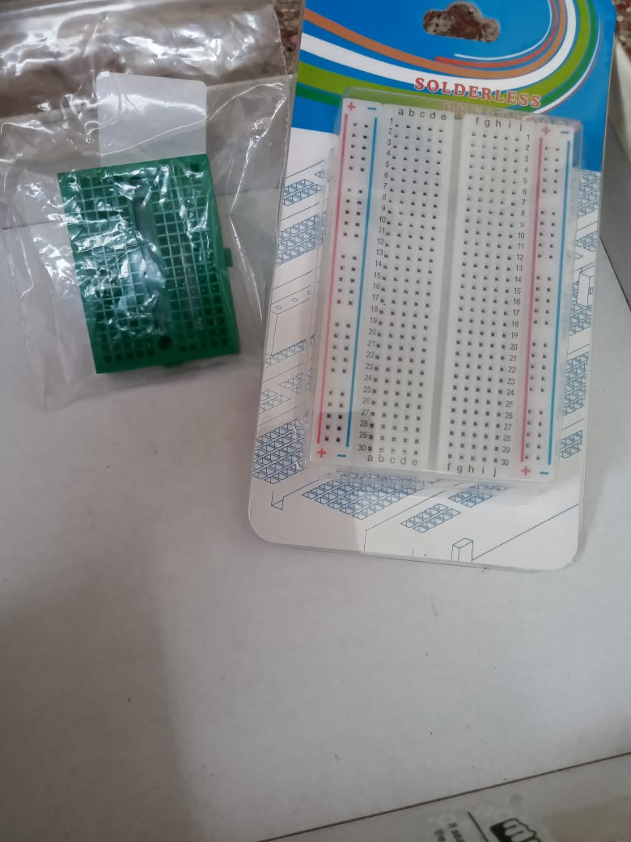
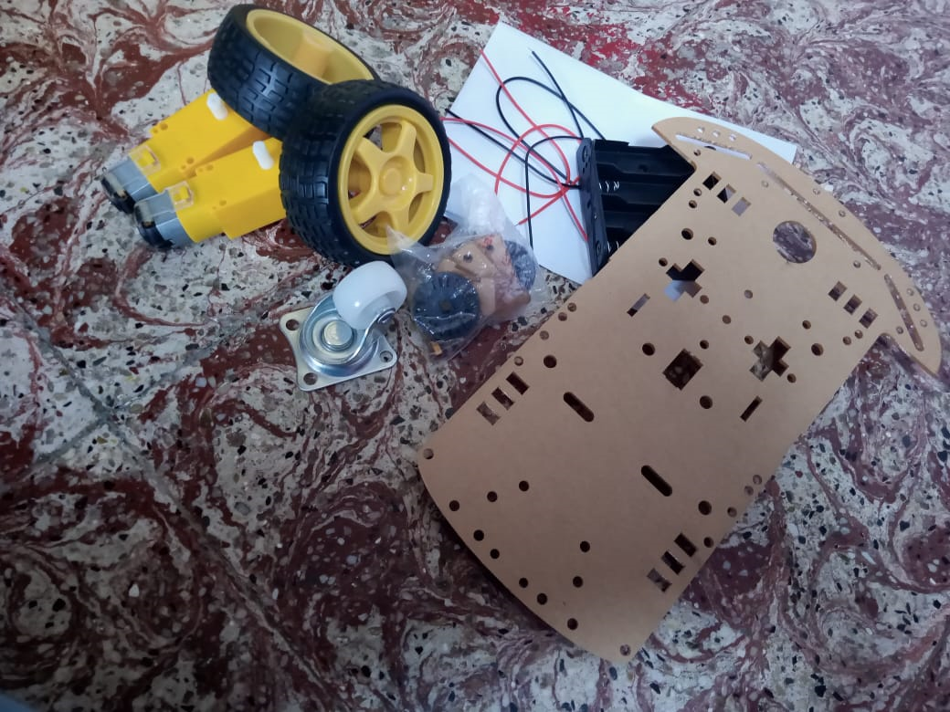
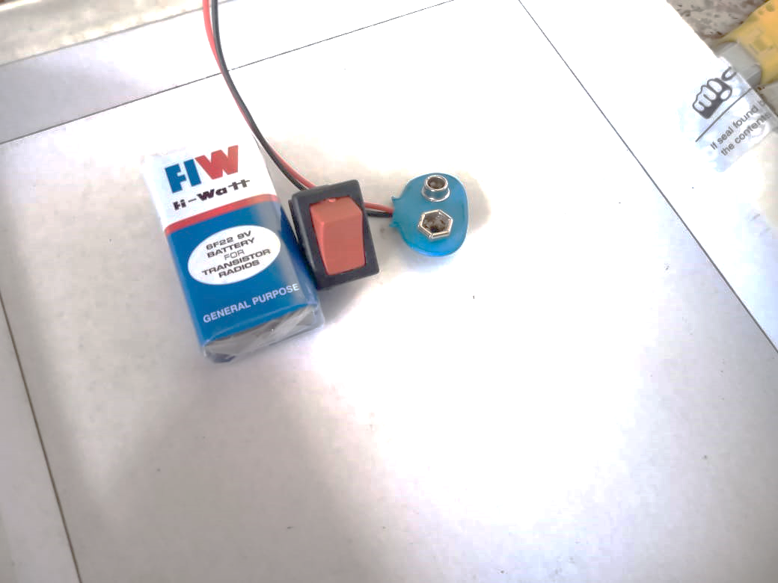
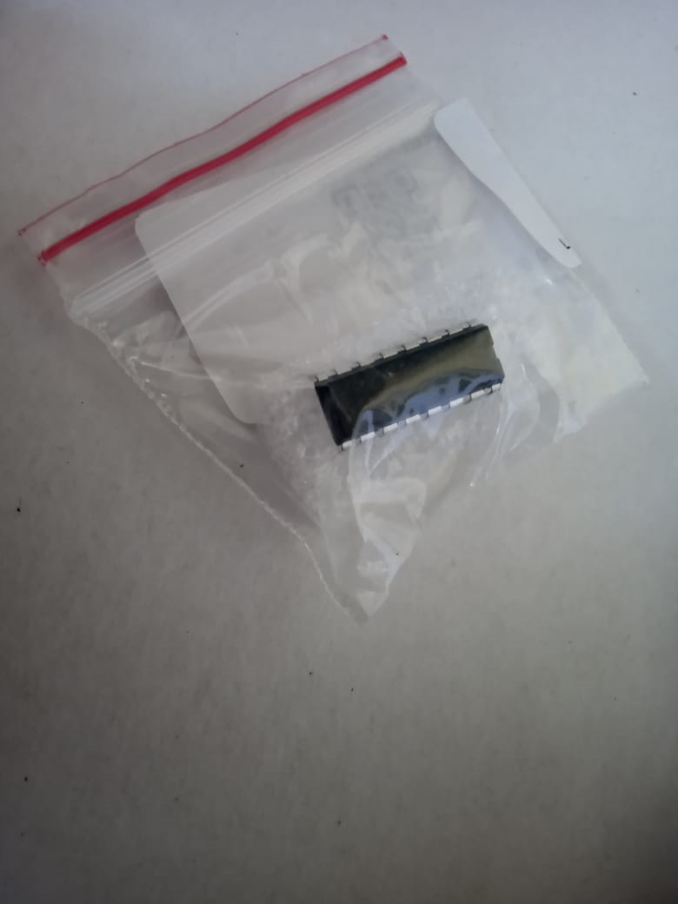
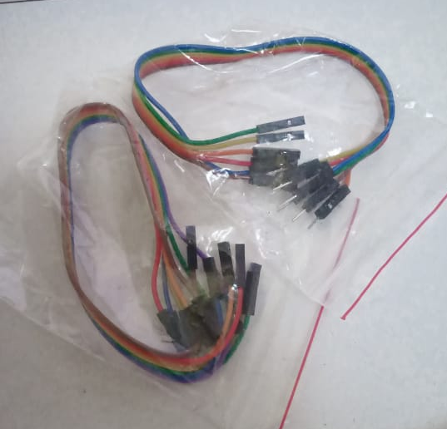
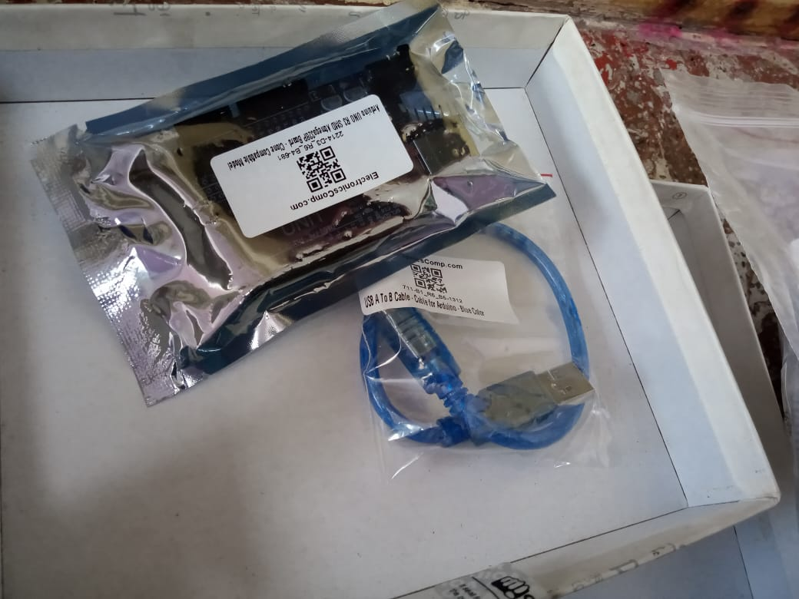
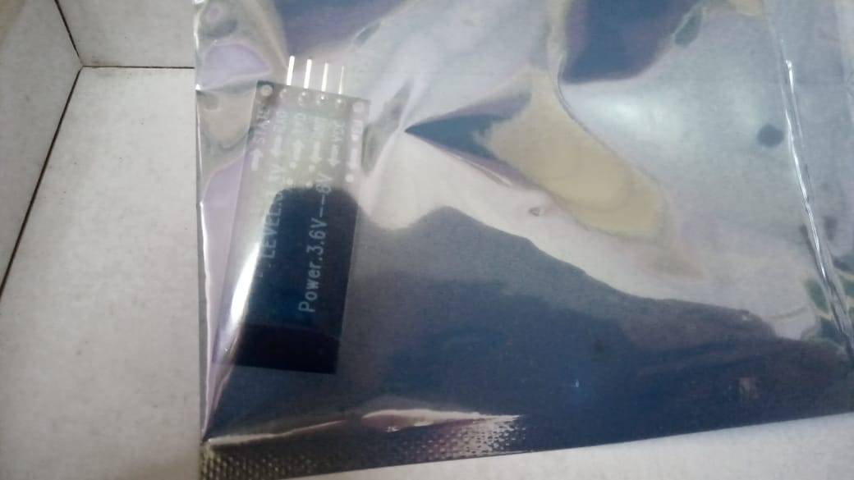
IMPLEMENTATION
COMPONENTS
Breadboard
Chassis Kit
Battery and its
cap, switch
Motor Driver IC
L293D
Microcontroller
Arduino Atmega328P
Bluetooth module
HC06
Jumper wires

Slide 8
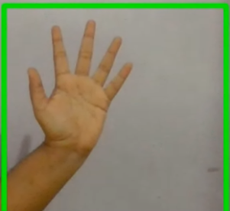
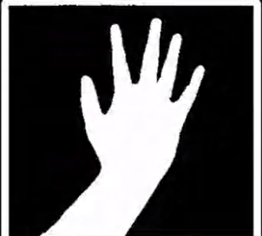
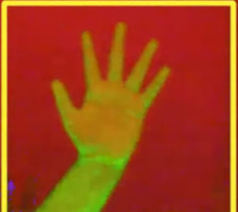
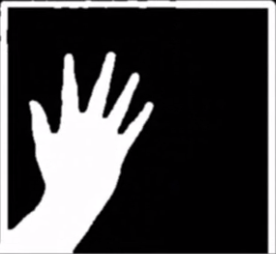
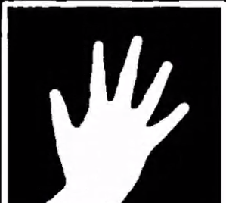
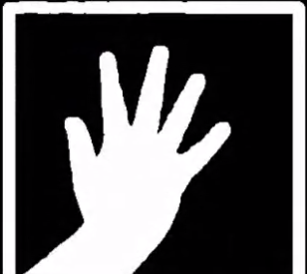
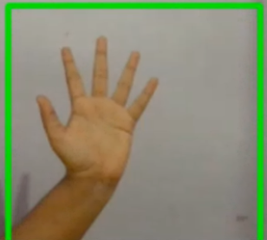
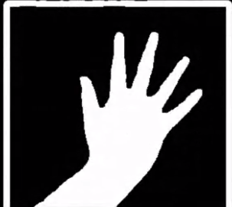
OUTPUT IMAGES
ORIGINAL IMAGE
MASKED IMAGE
HSV IMAGE
FILTERED IMAGE
ERODED IMAGE
DILATED IMAGE
BLURRED IMAGE
THRESHOLDED IMAGE

Slide 9
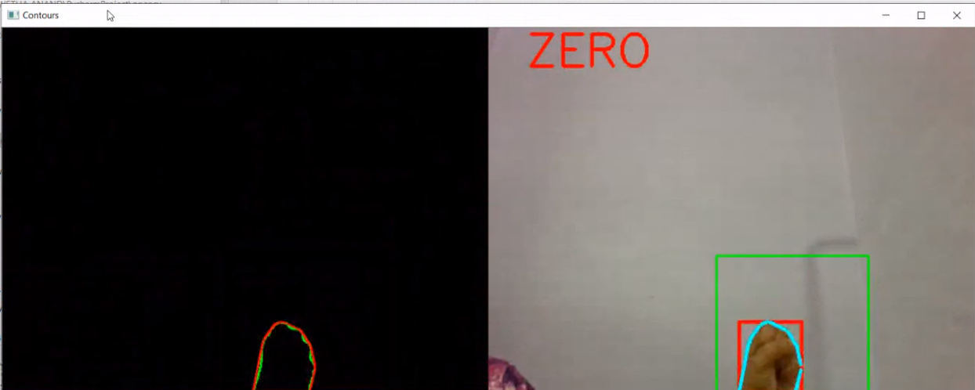
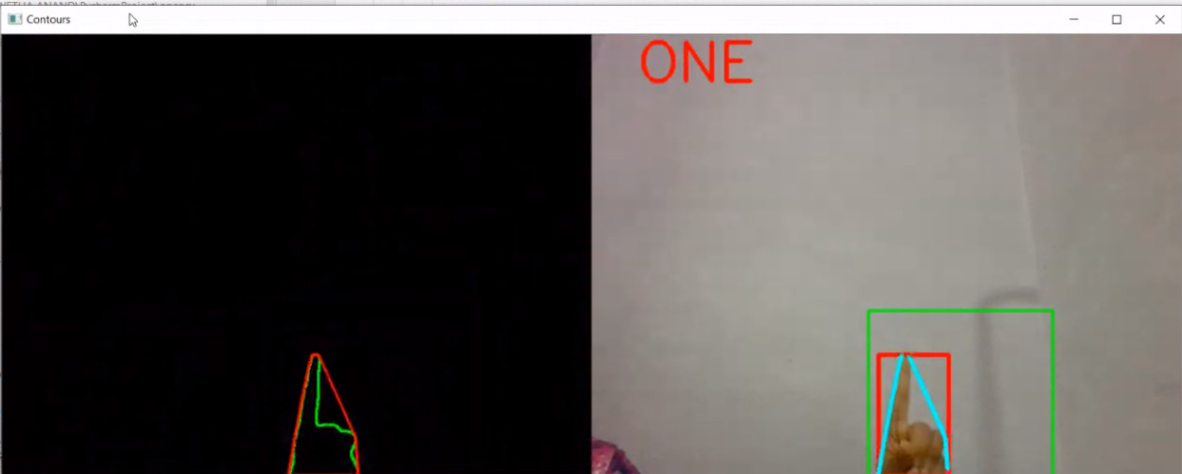
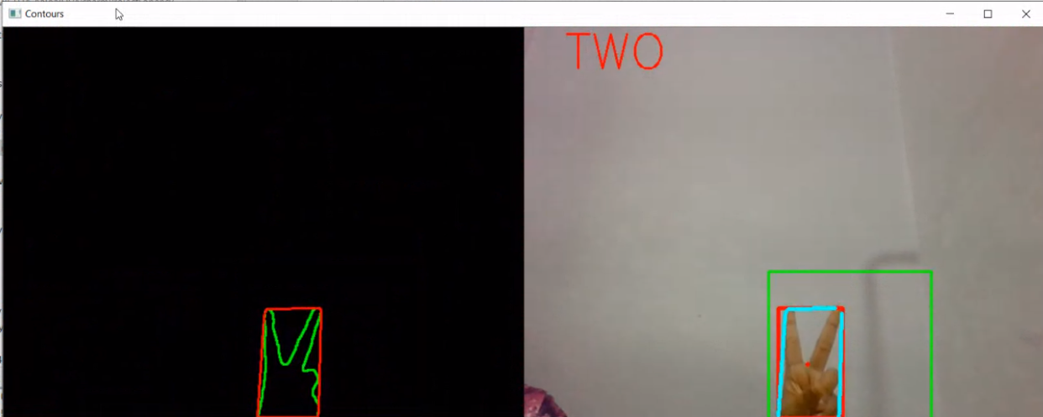
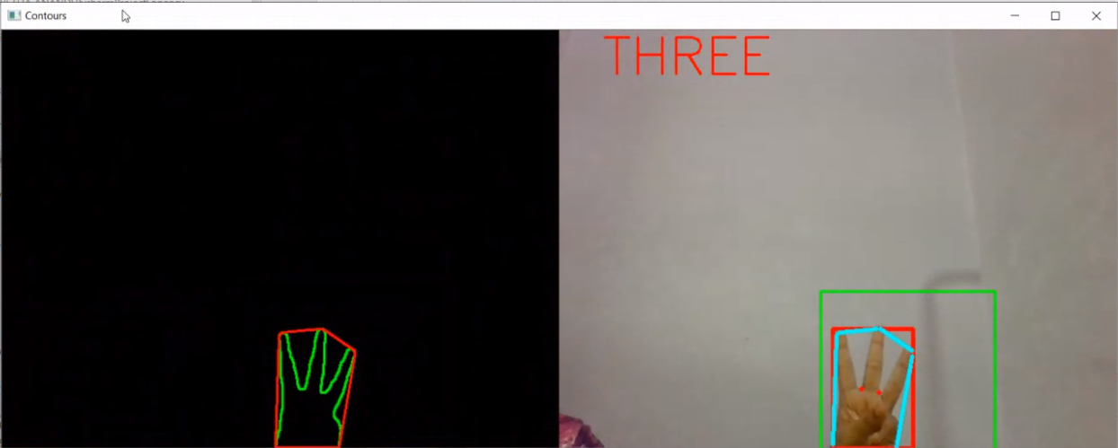
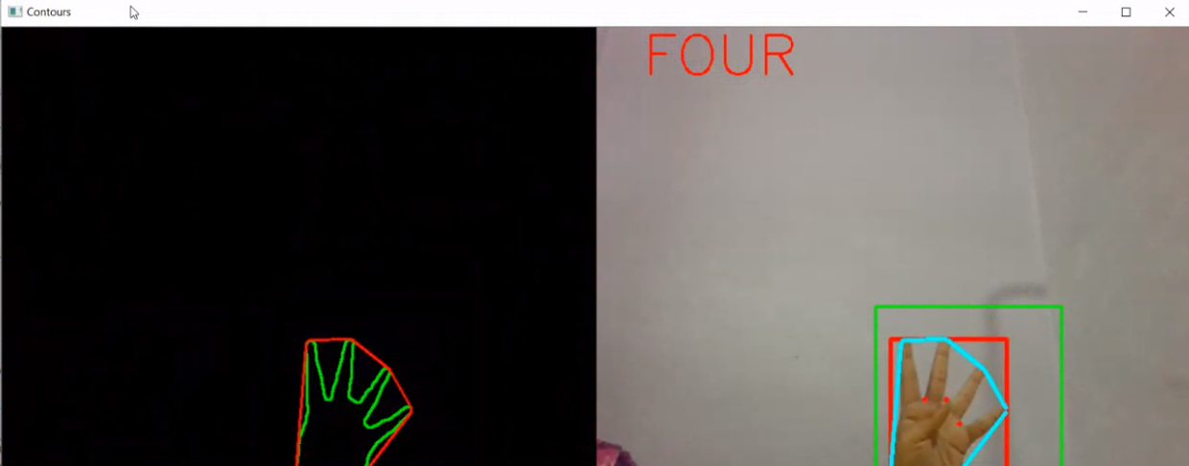
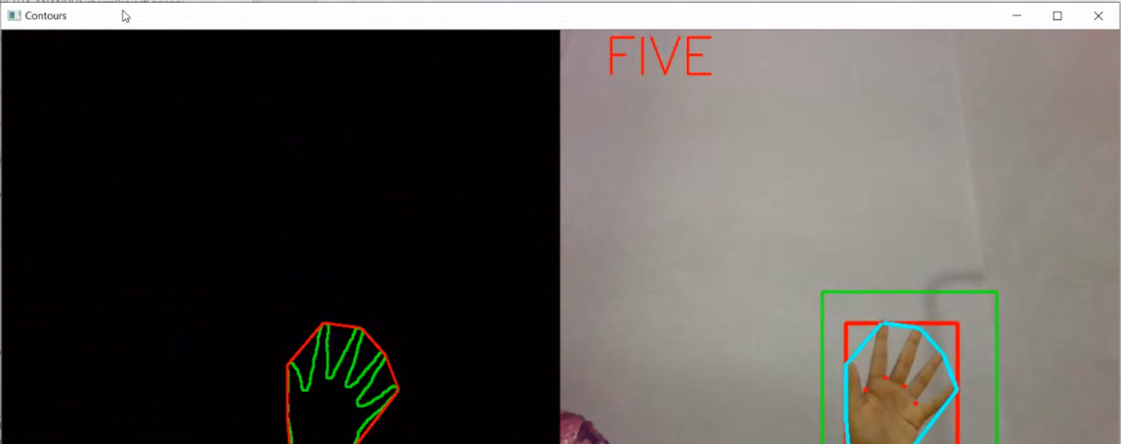
COMMAND DETECTION

Slide 10
CONCLUSION:
The Gesture controlled Robot System gives an alternative way of controlling robots. Gesture control being a more natural way of controlling devices makes control of robots more efficient and easy. We have provided a technique of finger count based gesture control, in which each finger count specifies the command for the robot to navigate in specific direction in the environment. After gesture recognition command signal and passed to the robot and it moves in specified direction.
REFERENCES:
“OpenCV-Python Tutorials Documentation”, Release 1, Alexander Mordvintsev and Abid K.
https://lastminuteengineers.com/l298n-dc-stepper-driver-arduino-tutorial/
https://medium.com/analytics-vidhya/hand-detection-and-finger-counting-using-opencv-python-5b594704eb08
https://colab.research.google.com/drive/1GnTbrruWpEUaqdo_2Bw_mvgfB2fUoyM9?usp=sharing#scrollTo=104r2HtWLRHr
https://www.codeproject.com/Articles/782602/Beginners-guide-to-understand-Fingertips-counting

Slide 11
THANK YOU!!!

